Slide 1


SAP S/4HANA CDS, RAP Training Day 11
Anubhav Oberoy

Slide 2

Agenda – Day 11
Implementing the Action createTravelByTemplate
Implementing Validations
Implementing the Determination
--Break
What is Draft
Enable Draft Handling
Expose Draft handling to projection Layer
Enable Early Numbering for Travel and Booking
Integrating augment in Managed Object
--Break
Understand the persona for Approver
Implementing Approver projection
Annotations for Approver Scenario
Behavior Definition for Approver
Service Binding for Approver Scenario
Fiori App for Approver
Notes:
https://unsplash.com/photos/CPs2X8JYmS8

Slide 3

























Slide 4

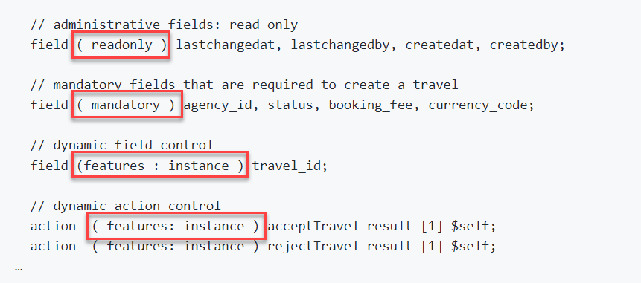
Modeling Static and Dynamic Feature Control
As an application developer you may want to determine, which entities of your business object should be create-, delete- and update-enabled, so that they can be modified during consumption using EML or OData services. In addition, you also may want control which (UI) fields of an entity are read-only or which actions in which usage scenarios are enabled or disabled for execution by the end users.
In ABAP RESTful programming model, the feature control is precisely the means of accomplishing such tasks. It allows you to control the visibility and changeability of fields, operations or entire entities.
Depending on whether feature control refers to specific instances or is independent of each entity instance, we distinguish between instance-bound and static feature control.
The availability of feature control values is modelled in a behavior definition. Unlike static, instance-bound feature control requires not only a definition but also an implementation in a handler class of the behavior pool. Therefore, we also talk about dynamic feature control in case of instance-bound feature control.
Both, static and dynamic feature control is defined for different levels (entity, field, or action level) in the behavior definition by using the following syntax:
Exercise
Dynamic Feature Control Code

Slide 5
Requirements
Make Administrative fields for Travel as Read Only
Make Travel Fields Mandatory for booking
Control the Accept and Reject Travel actions based on status
Make Connection fields mandatory for Booking
Control the Customer ID field based on Carrier, For AA make it Read only

Slide 6
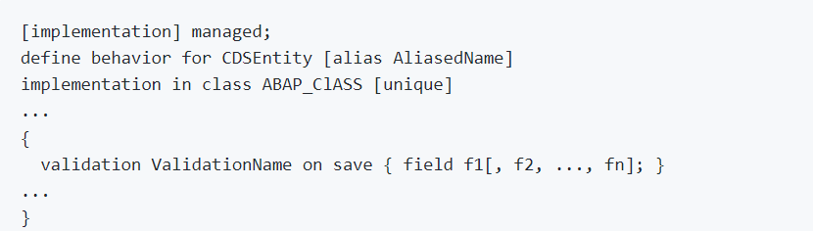
Implementing Validations
A validation is an implicitly executed function intended to check the data consistency of an existing instance of an entity (consistency validation). It is implicitly invoked by the business object’s framework as soon as a trigger condition at a predefined point in time is fulfilled. Validation can return messages to the consumer and reject inconsistent instance data from being saved.
Validations never modify any instance data but return the messages and keys of failed (inconsistent) entity instances.
Validations are specified for individual business object’s entities in the behavior definition by using the following syntax:

Slide 7
Use case for Validation
Check if the customer ID referenced in the Travel order is valid.
Check if the travel end date is more than Travel Start Date
Check if the status passed by User is valid.
These validations are assigned to the "Travel" entity having defined update as the trigger operation on entity "Travel". As soon as data is updated by the consumer, the validation will check it and return a warning message if the unusual condition arrives.
Exercise
Validation Code

Slide 8
Implementing the Determination
A determination is an implicitly executed function that handles side effects of modified entity instances. It is invoked by the business object’s framework as soon as a determination’s trigger condition at a predefined point in time, the determination time, is fulfilled.
Determinations are triggered internally based on changes made to the entity instance of a business object. The trigger conditions are checked by business object framework at different points during the transaction cycle, depending on the determination time and the changing operations on the relevant entity instances. For each determination, it is necessary to specify both the determination time and the changes that form the trigger condition. A trigger condition consists of a list of fields belonging to the same entity the determination is assigned to and the changing operations that include creating or updating entity instances. We call this operations trigger operations.
In case a field is changed (after creation or update), the condition is fulfilled. The framework evaluates the triggering condition of all determinations at certain points in time (determination time). For determinations, this is today either after each modification or during the save phase.
You can use a determination primarily to compute data that is derived from the values of other fields. The determined fields and the determining fields either belong to the same entity or to different entities of a business object.
As a result, determination can modify entity instances and return transition messages (error, warning, information, success).

Slide 9



























Slide 10
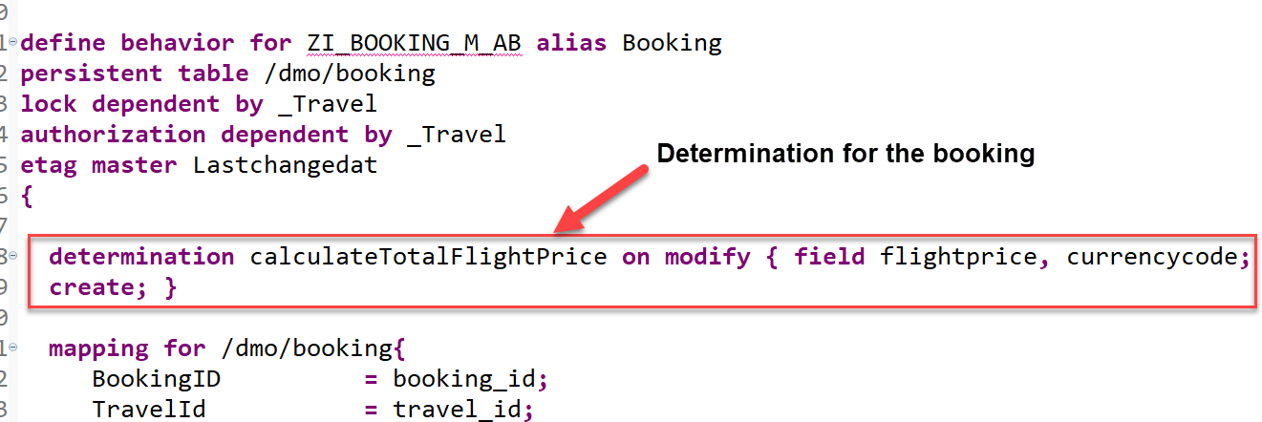
Implementing the Determination
The determination calculateTotalFlightPrice on the booking entity is intended to handle the calculation of total price of all flight bookings that belong to the selected travel.
The determination will be triggered by on modify as determination time when creating new booking instances or updating the flight price value or when changing the currency. In other words: both fields flight_price and currency_code serve as trigger fields and form together with create and update operations the trigger condition for the determination.

Slide 11
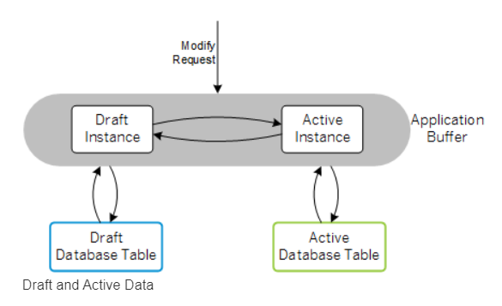
What is Draft?
You can draft-enable a business object to automatically persist transactional data in the backend. This approach supports stateless communication for your applications.
Modern cloud-ready apps require a stateless communication pattern, for example to leverage cloud capabilities like elasticity and scalability. Thus, there is no fixed backend session resource along a business transaction for each user and the incoming requests can be dispatched to different backend resources, which supports load balancing. On the other hand apps are stateful from end-user perspective. Business data that is entered by the end user needs to be locked, validated and enriched via ABAP business logic on backend side.
The draft concept fills the gap between a stateless communication pattern and a stateful application by applying REST principles:
The draft represents the state and stores the transactional changes on the database in shadow tables. It is an addressable resource, the exact copy of the active data that is currently being edited.
Draft-enabled applications allow the end user to store changed data in the backend and continue at a later point in time or from a different device, even if the application terminates unexpectedly.

Slide 12
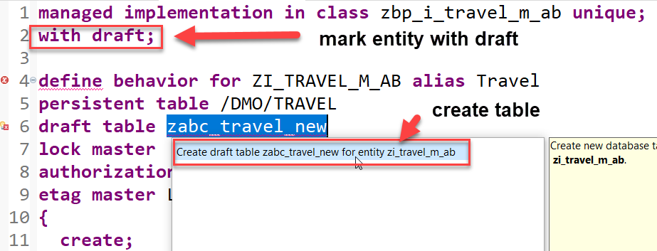
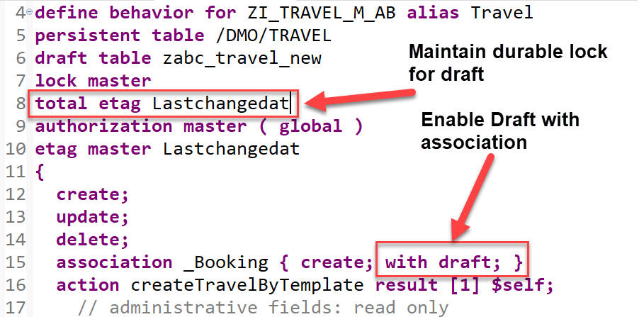
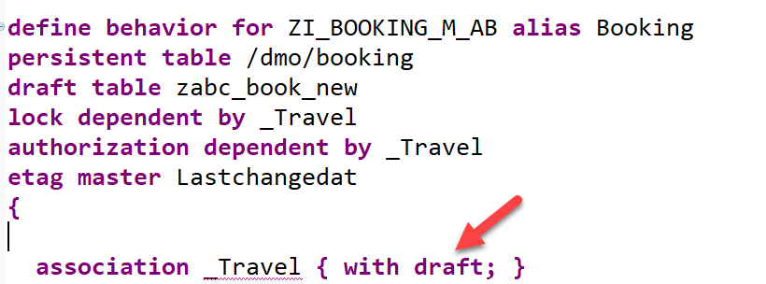
Steps to implement Draft
Draft tables are fully managed by the RAP framework at runtime
Add the addition with draft; after the managed; keyword in the header section to enable draft handling for your business object.
Specify the draft table for the travel & booking entity, where the draft travel data will be persisted as show on the screenshot.
Replace the association definition in the base behavior definition to solve the warnings indicating that the associations are implicitly draft enabled as this is a draft enabled business object. For this, use the code snippet provided below to replace the one currently defined in the travel behavior definition as shown on the screenshot. Do the same for the _Travel association.
Specify a total etag field in the root entity of your BO. This is required to identify changes to active instances in cases where the durable lock has expired. The field LastChangedAt will be used for the purpose in the present scenario.

Slide 13
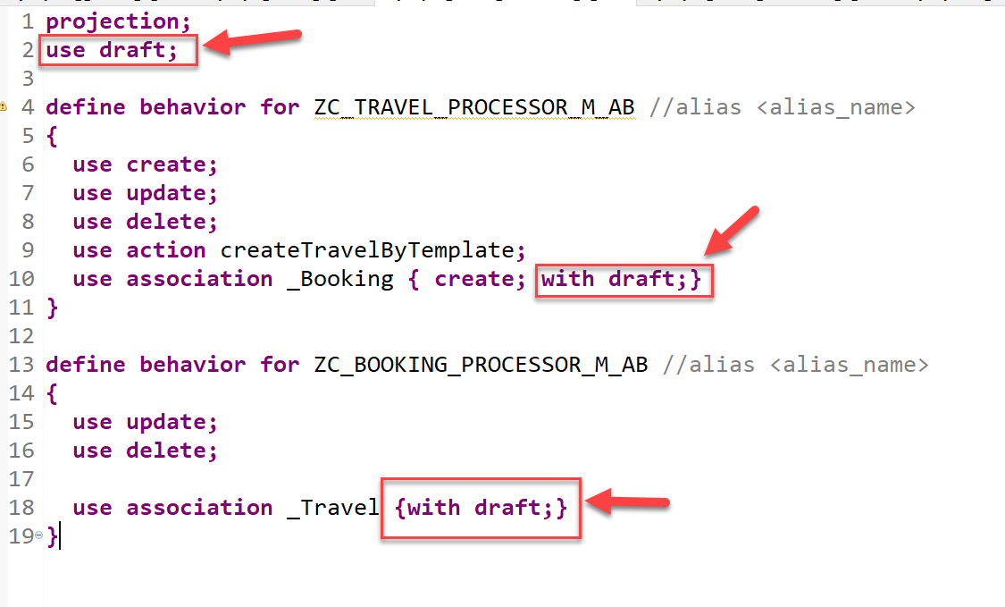
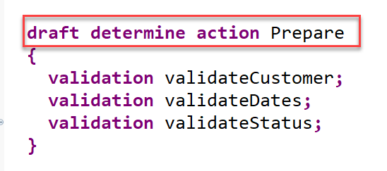
Steps to implement Draft
5. When a draft instance is going to be activated, the SAP Fiori elements UI calls the draft determine action prepare in the backend. This call takes place in a separate OData changeset to allow for saving the state messages even in case the activation fails due to failing validations. In order to execute the validations during prepare, you need to assign them to the draft determine action prepare trigger.
6. At Last, we will enable the draft handling for the managed based business object (BO) with a few additions in the behavior definition.
Draft Implementation Code

Slide 14
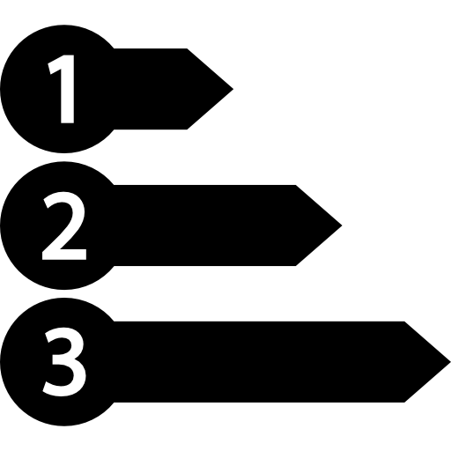
Enable Early Numbering for Travel and Booking
About Numbering
Numbering is about setting values for primary key fields of entity instances during runtime.
The primary key of a business object entity can be composed of one or more key fields, which are identified by the keyword key in the underlying CDS view of the business object. The set of primary key fields uniquely identify each instance of a business object. The primary key value of a business object instance cannot be changed after the CREATE.
There are various options to handle the numbering for primary key fields depending on when (early or late during the transactional processing) and by whom (consumer, application developer, or framework) the primary key values are set. You can assign a numbering type for each primary key field separately.
Early and Late Numbering
In an early numbering scenario, the primary key value is set instantly after the modify request for the CREATE is executed. The key values can be passed externally by the consumer or can be set internally by the framework or an implementation of the FOR NUMBERING method. For more information, see Early Numbering.
In a late numbering scenario, the key values are always assigned internally without consumer interaction after the point of no return in the interaction phase has passed, and the SAVE sequence is triggered. This ensures a gap free key value assignment like it is required for example for invoices. For more information, see Late Numbering.

Slide 15
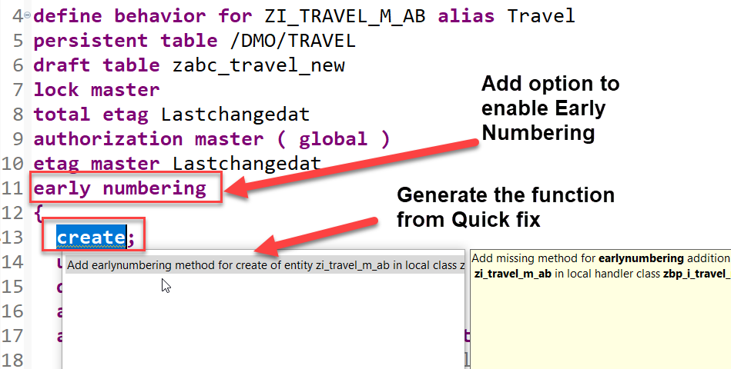
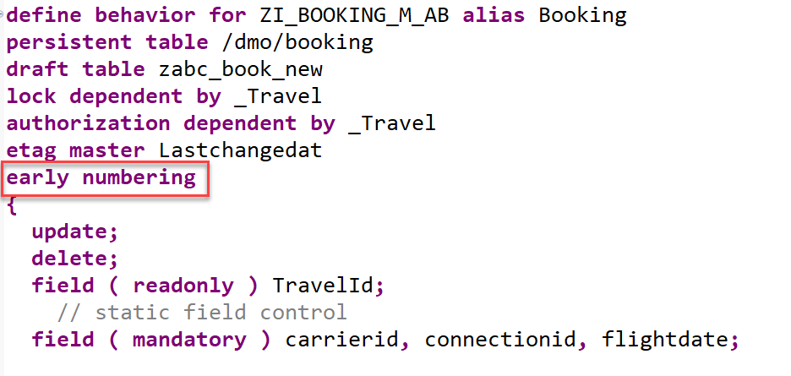
Implementation for Early Numbering
Add the addition early numbering keyword as shown below to enable early numbering for your travel entity.
The ADT Quick Fix feature can be used to add the earlynumbering method for travel entity.
Implement the function to handle early numbering – code here
Repeat the same for the booking by adding early numbering
Implement the function to handle early numbering – code here

Slide 16
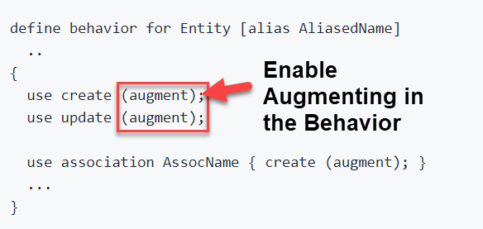
What is Augmenting
With an augmentation implementation you can add data or modify incoming requests on the projection layer before data reaches the transactional buffer. You can add data to a modify request or issue additional requests by augmenting the operation before the request is passed to the base business object.
Use case
• Defaulting for incoming requests.
• Behavior-enabling denormalized fields, for example enabling editing of language dependent fields.
Definition
Augmentation is defined in the projection behavior definition on the relevant operation with the following syntax:

Slide 17
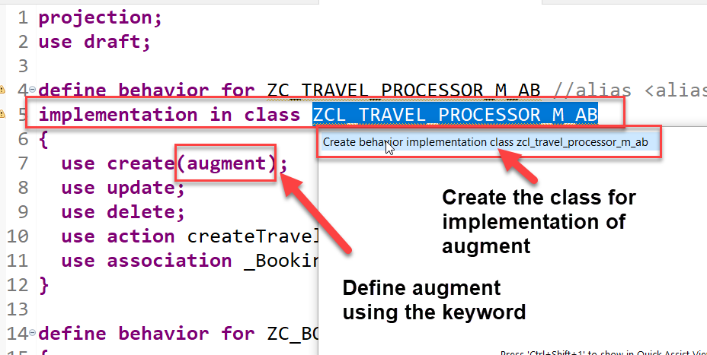
Use case and Implementation
We want to auto populate the agency id and the status of a new travel request during creation. The business has already provided default values which needs to be made available on fiori app.
Process
In our projection behavior definition, define augmentation for the create operation.
Add behavior implementation class to the Travel behavior.
The ADT Quick Fix feature can be used to create implementation class for travel entity.
Write the code to implement the default values for the agency id and status- Code here

Slide 18

Understand the Persona for Approver
The business object projection is the basis for a UI service that contains the functionality that is relevant for an approver. Imagine a person, maybe a manager of a travel agency, that approves the data that was entered by the processor. That means, this person sees the travel information and the corresponding booking data. Based on this data, the approver can either accept or reject the travel. For a minimal scope of fields in the travel entity the approver is enabled to edit the values, for example the BookingFee or the Description. The information about bookings is set to read-only for the approver. The approver is not allowed to change the fields of the booking entity.
Approver
Accept
Reject

Slide 19
Approver Scenario
Travel Projection CDS View for Approver BO
Except for the actions, which are different in the processor and the approver projection, the CDS projection views for the processor and the approver BO are identical. Minor changes can be detected in the field label of the field TravelID and TravelStatus. This results from the fact, that the approver does not create new travel entries. It is not necessary for this role to know the number range of the TravelID or the possible values of the TravelStatus. In addition, the approver BO projection has gained a selection field for the TravelStatus to make it easier for the approver to filter for open/accepted/rejected travels.
Actions
The position and the label for the action button must be defined in the CDS projection views. In the case of an approver, the available actions concerning the travel entity set are Accept Travel and Reject Travel. The implementation of these actions is done in the behavior implementation . It is simply the UI appearance that needs to be configured in the projection view. The action buttons for the respective actions are designed to appear on the travel list report page and on the travel object page. That is why the annotations are used in the list item and identification UI annotation. When executing the action on the list report page, a travel instance must be selected to assign an instance for the instance-bound action. On the object page, the instance for which the action shall be executed is clear.
Booking Projection CDS View for Approver BO
The CDS projection views for the processor and the approver BO are almost identical.
Value helps are not necessary for the interpretation of the approver role in this scenario. As the booking entity is a read-only entity in this scenario and selection fields with value helps cannot be defined for a sub entity, value helps cannot be applied and thus are not necessary to be defined for the booking entity.

Slide 20
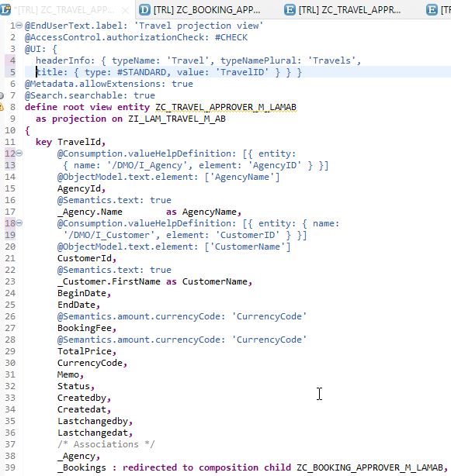
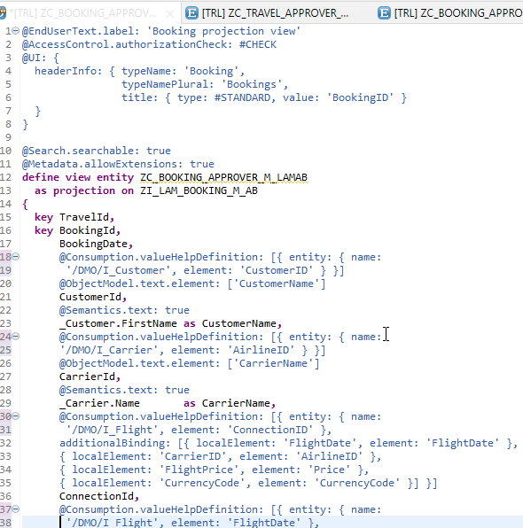
Implementing Approver Projection CDS
ZC_TRAVEL_APPROVER_M_LAMAB
ZC_BOOKING_APPROVER_M_LAMAB

Slide 21
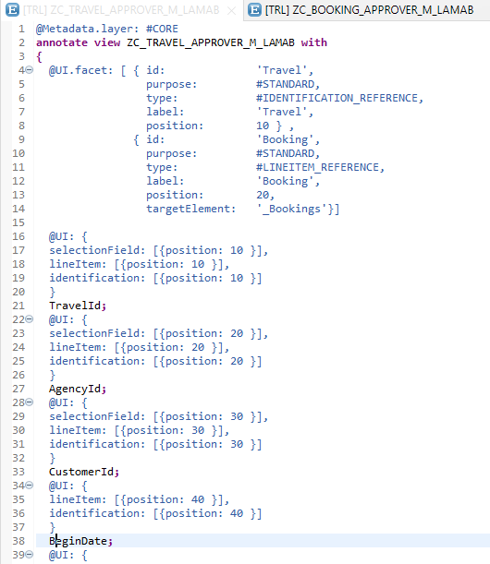
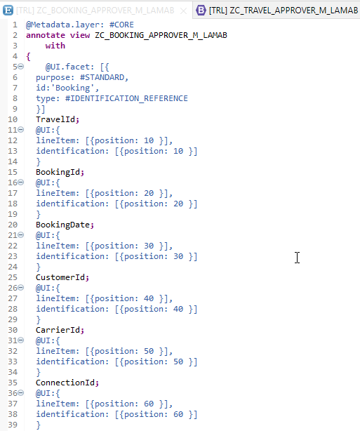
Metadata Extension
Metadata Extension for Travel
Metadata Extension for Booking

Slide 22
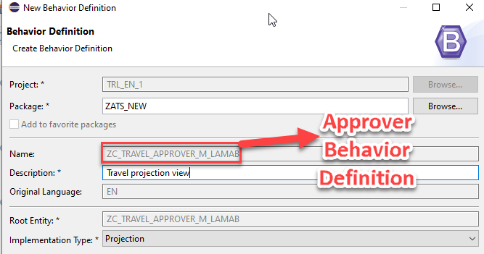
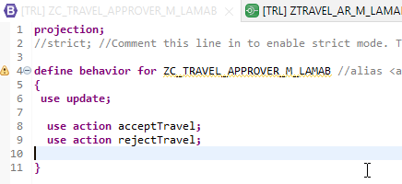
Behavior Definition for Approver
The scope of the UI service for the approver is more limited than for the processor. The approver can only modify the travel entity with accepting or rejecting the travel entries. The values in the corresponding booking entries are the basis for this decision-making.
The behavior for the BO projection is defined in a behavior definition of type projection. The type is defined in the behavior definition header. The projection behavior definition provides the behavior for the projection CDS view. All characteristics and operations that you want to include in the BO projection must be listed explicitly. The keyword for this is use. - Code here

Slide 23
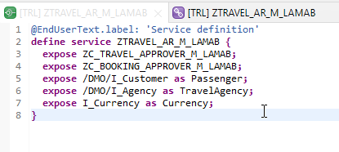
Service Definition
The service definition is a projection of the models and related behavior that you want to expose.
In a service definition, you define the OData service to determine which CDS entities are part of the service. This service is then bound to a protocol and to either a UI technology or an A2X service by a service binding artifact. A service definition can be integrated in various protocols without any reimplementation.
Service definition is used to assign the scope of the OData service. Travel, Booking, Passenger, TravelAgency, Currency CDS views are exposed in the service definition. Optionally, you can assign an alias for the each exposed CDS view
Exercise
Service Definition

Slide 24
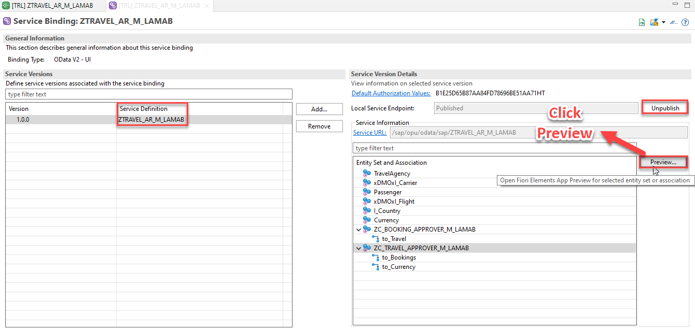
Service Binding
A service binding implements the protocol that is used for the OData service. It uses a service definition that projects the data models and their related behaviors to the service.

Slide 25
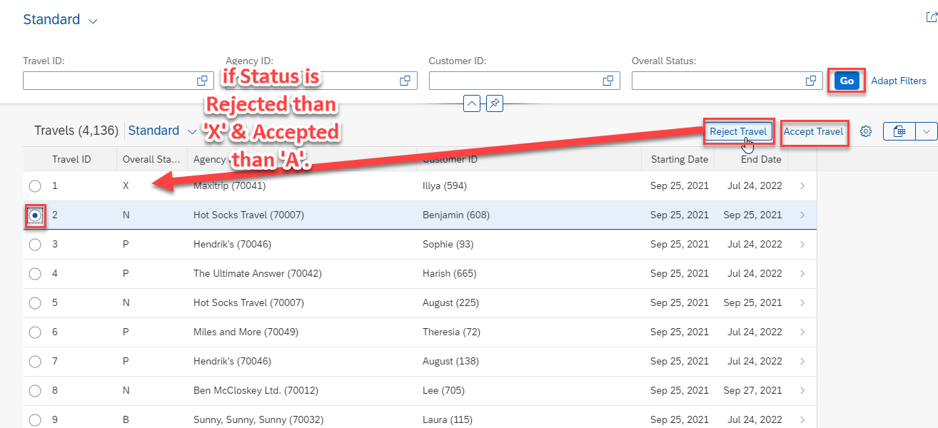
Fiori App Preview

Slide 26
Title
Text

Slide 27
Title
Text

Slide 28

Questions?

Slide 29

Thank you
Anubhav.abap@gmail.com
contact@anubhavtrainings.com
+91 84484 54549
www.anubhavtrainings.com

